Slide 1


Apache Zeppelin Notebook
Presented By:
James Kocher
Apoorva Shukla
Yue-Ru (Norton) Li
Date: 03/27/2020
Logo citation: https://www.nobleprog.com/apache-zeppelin-training, https://zeppelin.apache.org/assets.html

Slide 2
About Apache Zeppelin
Web based notebook (created on 2013) providing interactive analytics with built-in data visualizations and collaboration opportunities by sharing data and code
Focus on enterprise users: Most enterprises with already operating databases and analytics systems can use it “Out-of-Box”. If desired, own analytics systems can be built exclusively from databases and Zeppelin.
Key Features: Data Ingestion, Discovery, Analytics and Visualization

Slide 3

Multiple language backend: Data Interactive
Supports:
Spark, JDBC, Pig, Beam, Scio, BigQuery, Python, Livy, HDFC, Alluxio,Hbase, Scalding, ElasticSearch, Angular, Markdown, Shell, Flink, Cassandra, Geode, Ignite, Lens, Kylin and PostgreSQL.

Slide 4
Comparison Apache Zeppelin v.s. Jupyter Notebook
 | Apache Zeppelin | Jupyter Notebook
Community | small user population (1/10th of the Jupyter Notebook) | large user population
Configuration | a separate interpreter configuration page | a little un-elegant
Extension | less extensions available | more extensions available
Installation | Decompress tarball and run server, for more feature, built it from the source | simple anaconda Install
Kernels | Large list, more than 85 of supported engines | 20 supported engines
Compatibility with OS | Doesn’t work for Win 10 | All standard system
Interpreters | Wide range: Spark, md, angular, Scala, python, pig, sap, groovy, elasticsearch, PostgreSQL, R | R, C#, php, F#, python, SQL, JS, JAVA
References: https://analyticsindiamag.com/jupyter-vs-zeppelin-a-comprehensive-comparison-of-notebooks/

Slide 5
Contrast against Jupyter Notebook
 | Zeppelin | Jupyter Notebook
Appearance | combine multiple paragraphs of code in Python in one single line; built in data visualization tool | not allow combine multiple paragraphs of code
Multi-User Capability | Yes | Not Support by default, use JupyterHub
Plotting of charts | Multiple interpreters in the same notebook to plot charts | Zero charting options, use existing charting libraries, output in HTML file
Report Describing | Interactive form and visualization results in a faster way, more accurate and easily accessible to end users | Less choice and longer processing time
Security | Flexible security configuration | No privacy configuration
References: https://analyticsindiamag.com/jupyter-vs-zeppelin-a-comprehensive-comparison-of-notebooks/

Slide 6
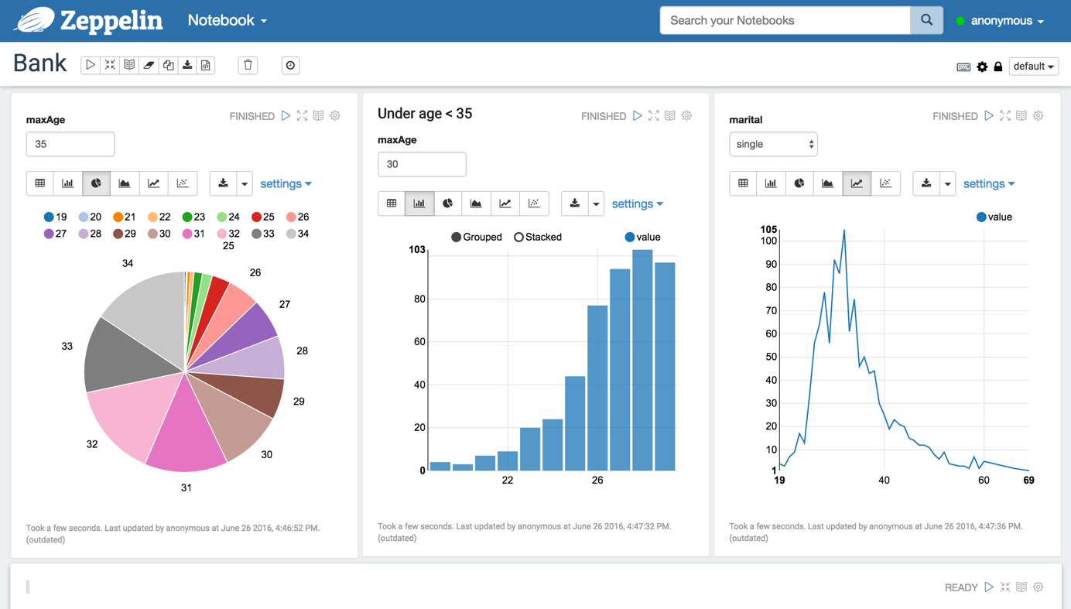
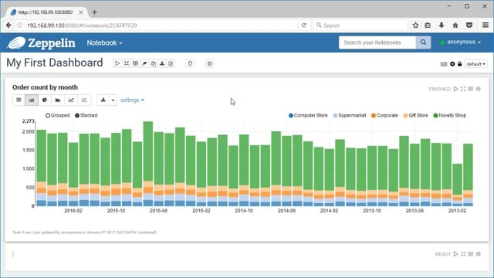
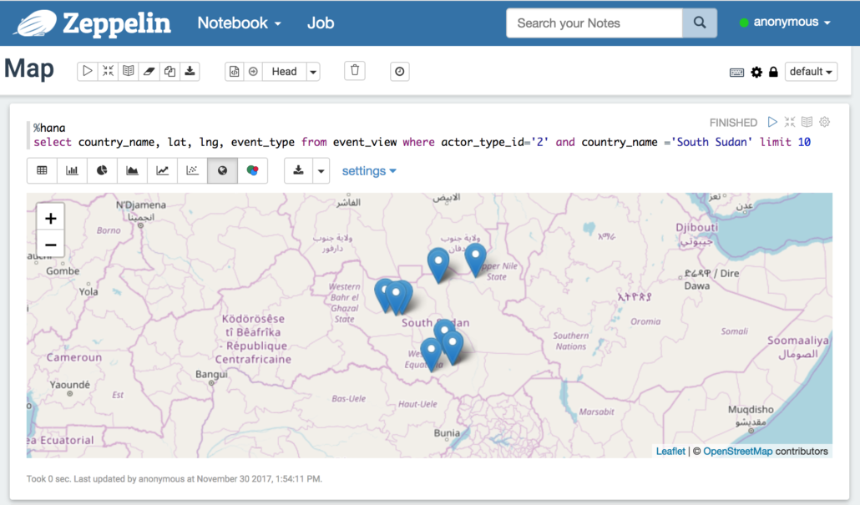
Zeppelin:
Easy and safe way to make data interactive together
Reference: https://vimeo.com/198582184

Slide 7
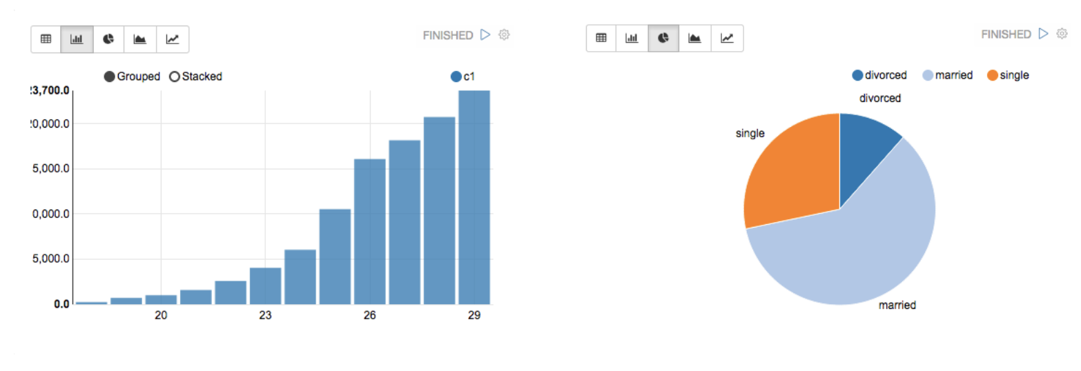
Zeppelin Over Jupyter
Secure Collaborations
Security measures
Real time changes
Sharing - read only, read and edit
Embedding link
Extensive Graphing Capabilities
Easily switch between views →
Pivot tables
Integrations with big data
Zeppelin offers the possibility to mix languages across cells
Database Interpreter

Slide 8
bedankt
cảm ơn bạn
Danke
hvala
תודה
Σε ευχαριστώ
Thank You
Question?
谢谢
ありがとう
merci
mulţumesc
شكرا لك
ačiū
obrigado
감고맙습니다사합니다
Благодаря ви
gràcies
salamat
Спасибо
terima kasih
Credit and Works:
Slide 2&3 Apoorva
Slide 4&5 Yue-Ru (Norton)
Slide 6&7 James
Template Design: Yue-Ru (Norton)
grazie
धन्यवाद

Slide 9
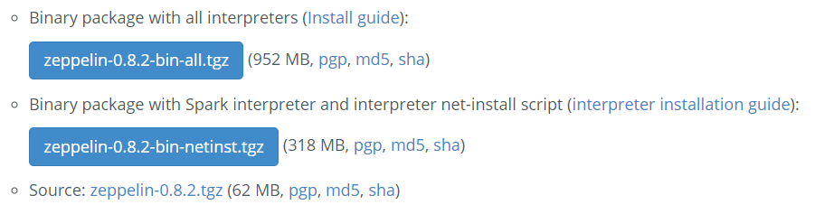
Installation of Apache Zeppelin Notebook Mac OS Version
Go to http://zeppelin.apache.org/download.html, download zeppline-0.8.2-all-tgz
Check your system environment: Oracle JDK 1.7 or above and Mac OSX
Unpack the file and then run: ./bin/install-interpreter.sh –all
Start command bin/zeppelin-daemon.sh start
Go to web browser, type in http://localhost:8080

